Slide 1
Coptic Lesson 5
The Rest of the Coptic Letters

Slide 2
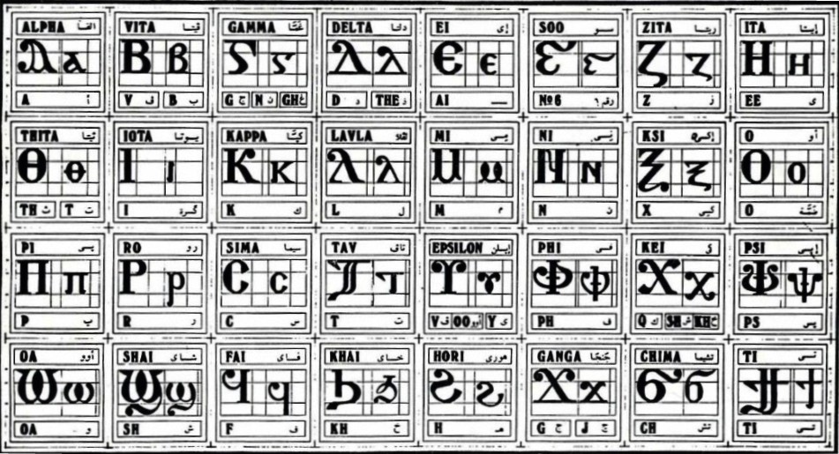
Coptic Alphabets

Slide 3
The Last Five Letters
^ = 6 (Soo)
X x = x (Ksi)
U u = v, oo, y (Epsilon)
F f = f (Fai)
H h = h (Hori)

Slide 4
Review
^ x u f h ou
L : P V ' [
S q J G
D Y R <
A B E Z I K M N O C T W

Slide 5
Review Questions
q
kh
Khai
^
6
Soo
f
f
Fai
[
ch
Chima
'
ps
Psi
x
x
Ksi
h
h
Hori

Slide 6
Coptic Reading – Part 1
va ve vy vi vo vw vou
xa xe xy xi xo xw xou
ja je jy ji jo jw jou
fa fe fy fi fo fw fou
ha he hy hi ho hw hou
[a [e [y [i [o [w [ou
'a 'e 'y 'i 'o 'w 'ou

Slide 7
Coptic Reading – Part 2
a] e] y] i] o] w] ou]
ax ex yx ix ox wx oux
av ev yv iv ov wv ouv
af ef yf if of wf ouf
ah eh yh ih oh wh ouh
a' e' y' i' o' w' ou'
aq eq yq iq oq wq ouq

Slide 8

Coptic Alphabet Song

Slide 9
Coptic Alphabets

Slide 10
Announcement
Coptic Servant is working next Saturday.

Slide 11

Oujai qen `P[oic

